Slide 1
Second Midterm review

Slide 2
Pipeline of Hypothesis test
Check Assumptions
Compute the test statistics by identifying the pointwise estimate and the standard error
Compute the p-value by identifying the test statistic’s distribution under the null hypothesis
Compare p-value with the significance level to conclude

Slide 3
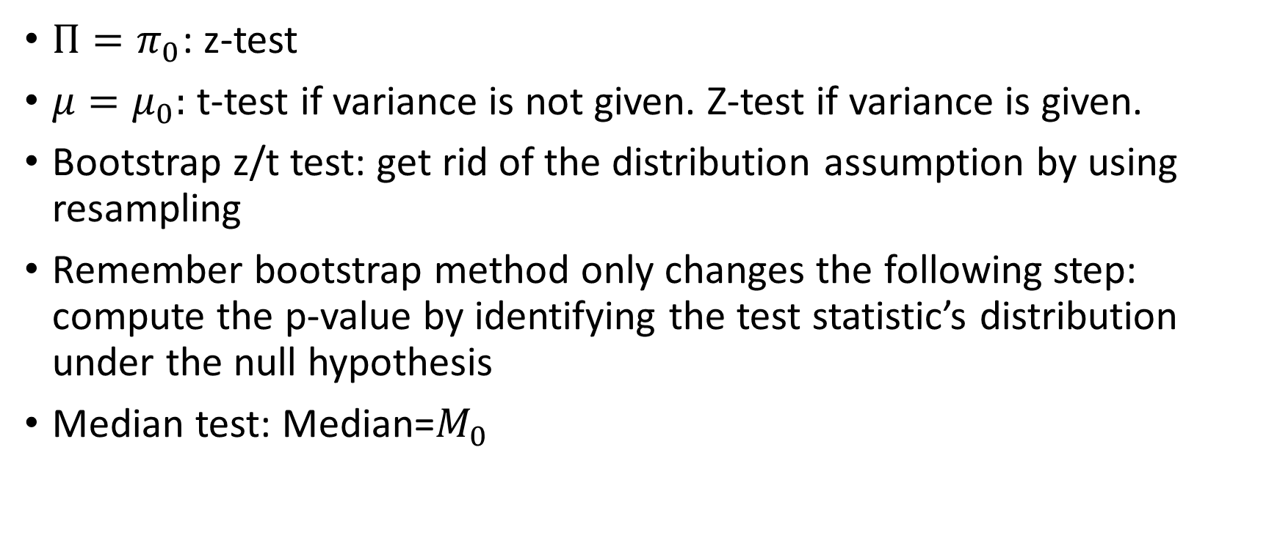
One sample test/ confidence interval
$Π=π_{0}$: z-test
$μ=μ_{0}:$ t-test if variance is not given. Z-test if variance is given.
Bootstrap z/t test: get rid of the distribution assumption by using resampling
Remember bootstrap method only changes the following step: compute the p-value by identifying the test statistic’s distribution under the null hypothesis
Median test: Median=$M_{0}$

Slide 4

One sample test assumptions
i.i.d.
Normality of $\overline{X}$
simple random sample: for binomial distribution.

Slide 5

Two sample test
$Π_{1}−Π_{2}=a$
$μ_{1}−μ_{2}=a$

Slide 6
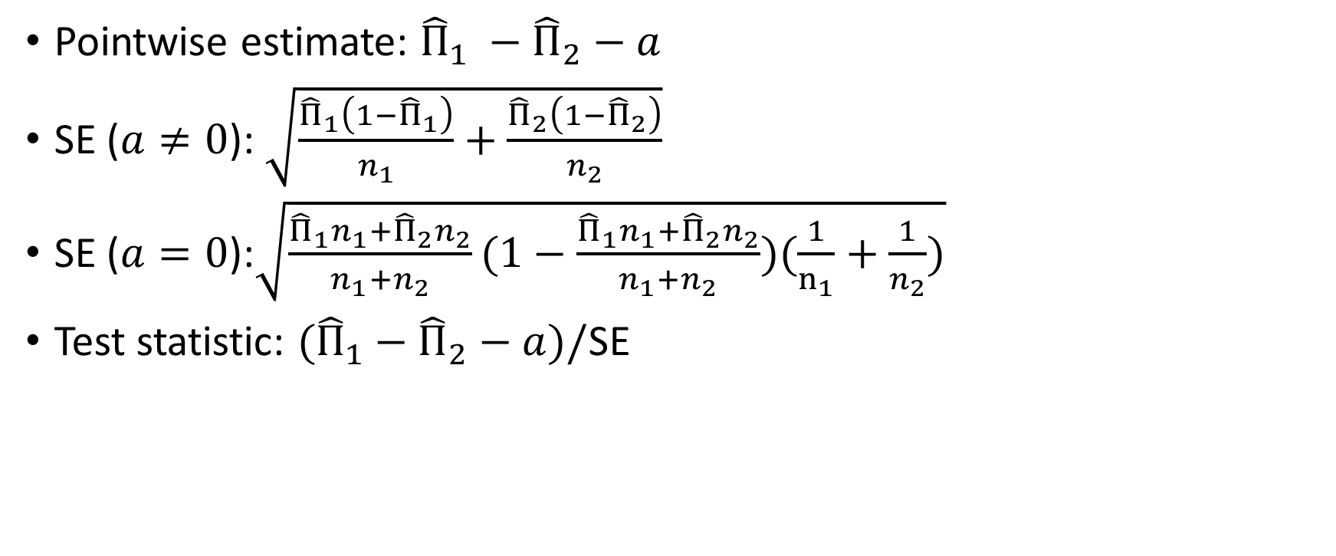

$$Π_{1}−Π_{2}=a$$
Pointwise estimate: ${{\hat{Π}}_{1}}_{ }−{\hat{Π}}_{2}−a$
SE ($a≠0$): $\sqrt{\frac{{\hat{Π}}_{1}\left({1−\hat{Π}}_{1}\right)}{n_{1}}+\frac{{\hat{Π}}_{2}\left(1−{\hat{Π}}_{2}\right)}{n_{2}}}$
SE ($a=0$):$\sqrt{\frac{{\hat{Π}}_{1}n_{1}+{\hat{Π}}_{2}n_{2}}{n_{1}+n_{2}}(1−\frac{{\hat{Π}}_{1}n_{1}+{\hat{Π}}_{2}n_{2}}{n_{1}+n_{2}})(\frac{1}{n_{1}}+\frac{1}{n_{2}})}$
Test statistic: ${{(\hat{Π}}_{1}}_{ }−{\hat{Π}}_{2}−a)/$SE

Slide 7
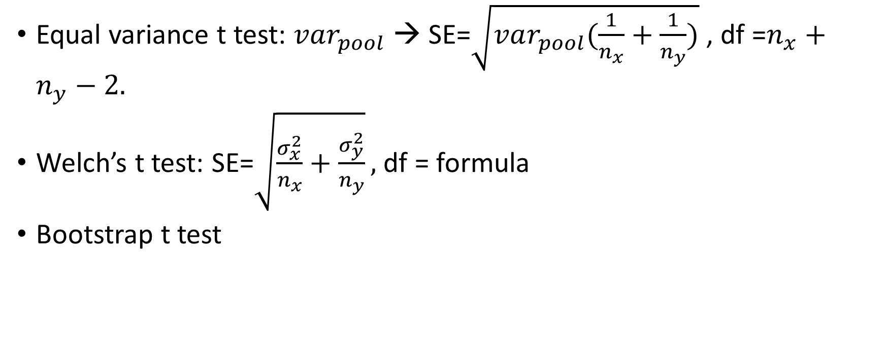

$$μ_{1}−μ_{2}=a$$
Equal variance t test: $var_{pool}$→ SE=$\sqrt{var_{pool}(\frac{1}{n_{x}}+\frac{1}{n_{y}})}$ , df =$n_{x}+n_{y}−2.$
Welch’s t test: SE=$\sqrt{\frac{σ_{x}^{2}}{n_{x}}+\frac{σ_{y}^{2}}{n_{y}}},$df = formula
Bootstrap t test

